Slide 1
A Brief Review of
Univariate Statistics

Slide 2
Today . . .
  Extending ANOVA to repeated measures (the M matrix)
  Combining group comparisons (L matrix) with repeated measures (the M matrix)

Slide 3
Analysis of variance designs can be extended to include measures collected repeatedly for each person . . .
 | Time 1 | Time 2 | Time 3 | . . . | Time t
Treatment
Control

Slide 4
and multiple treatment levels that are given to each person . . .
 | Treatment A₁ |  | Treatment A₂
 | Time 1 | Time 2 | Time 1 | Time 2
Treatment B₁
Treatment B₂
In these designs, the total variability (SS_{Total}) is still partitioned into parts representing systematic and random variability, but now there are more parts. Some new assumptions must be satisfied as well.

Slide 5
There are a variety of ways to get the ANOVA model with repeated measures in R. Depending on the method used, the data will need to be in either wide (traditional) format or long format.
Data in wide format have all information for each case in a single row; multiple columns contain the repeated measures.
Data in long format have each repeated measure in a separate row. A single column contains all of the repeated measures values.

Slide 6
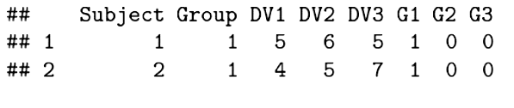
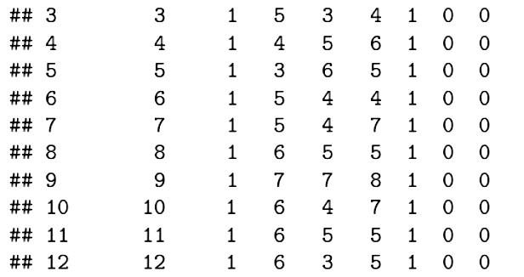
Wide Format

Slide 7
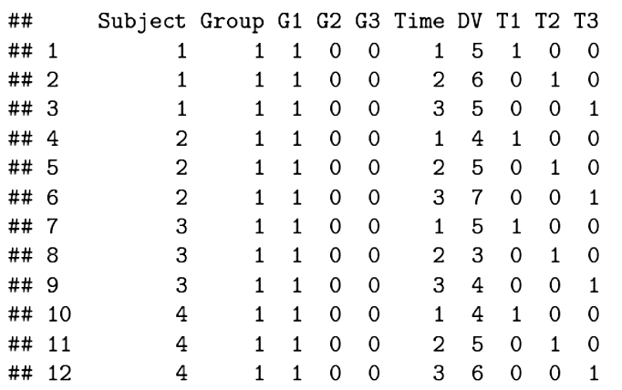
Long Format
We will treat these data as coming from a 3 x 3 (Group x Time) design.

Slide 8
The traditional approach using the aov() function requires the data in long format. Group, Time, and Subject must be specified as factors. In a repeated measures design, the repeated measure, Time, is considered to be nested within the Subject factor (i.e., each case has its own profile of scores). The Error( ) designation is needed to define the error terms correctly.

Slide 9
The standard ANOVA model assumes the factors are fixed. What does that mean?
The aov( ) function produces Type I sums of squares rather than Type II or Type III sums of squares. What does that mean and when will it matter?

Slide 10
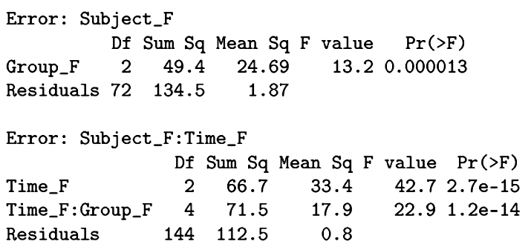
We have three significant effects. What can we tell about them from this information? Why do we have two different error terms?

Slide 11
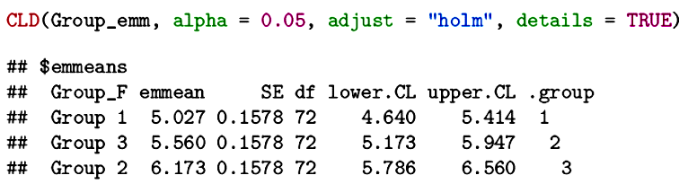
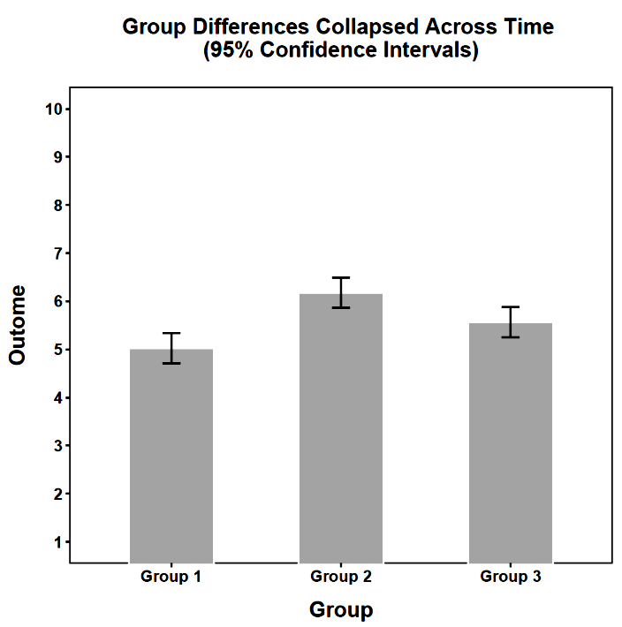
Pairwise comparisons can help isolate the nature of the main effects and interaction. The emmeans package provides a convenient way to do this.

Slide 12
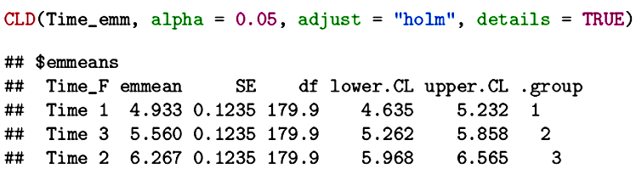
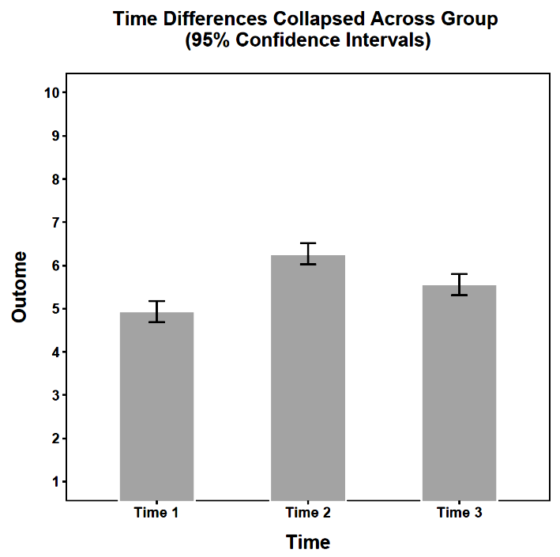

Slide 13
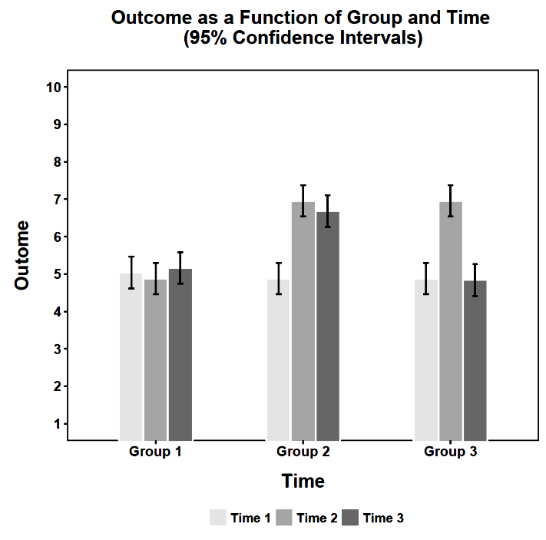

Slide 14
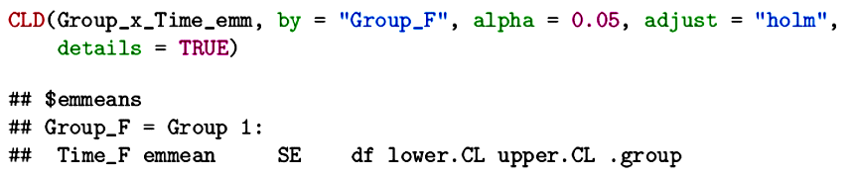
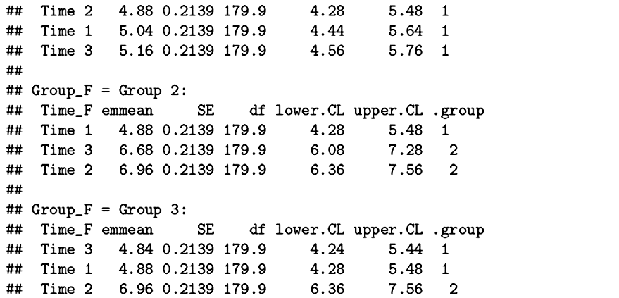

Slide 15
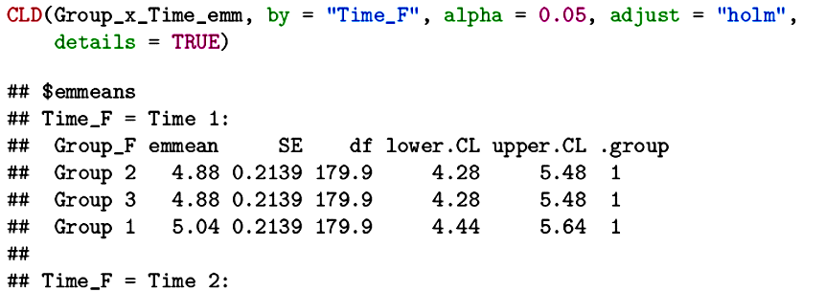
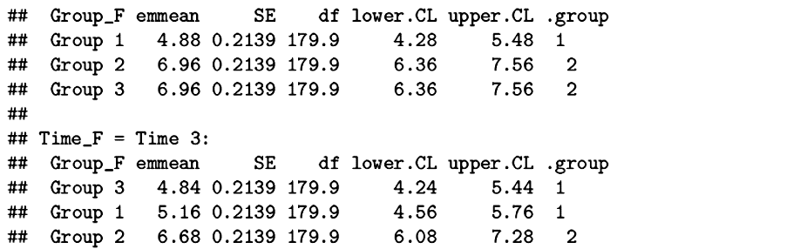

Slide 16
The analysis of variance makes several assumptions. The residuals are assumed to be normally distributed. The variance-covariance matrices for the repeated measures are assumed to be homogeneous across between-subjects conditions (Group in this case). The repeated measures are assumed to satisfy the sphericity assumption.

Slide 17
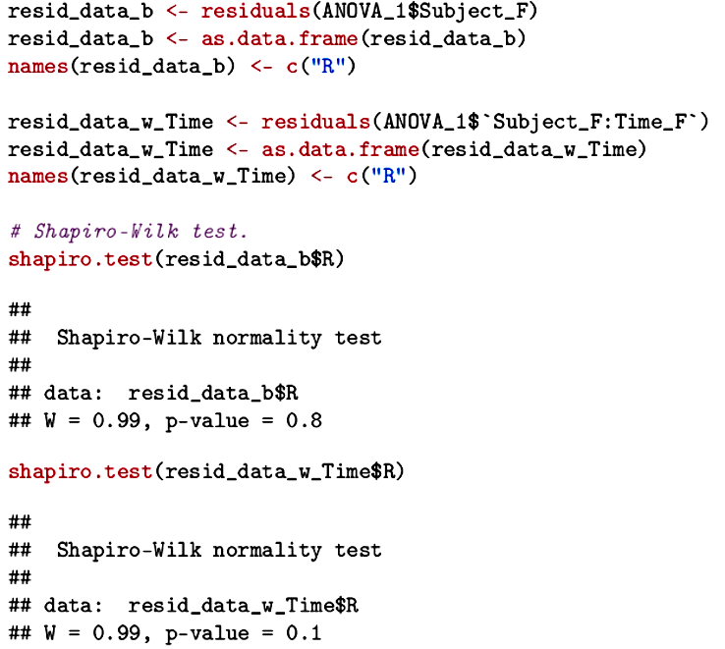
Both sets of residuals are normally distributed.

Slide 18
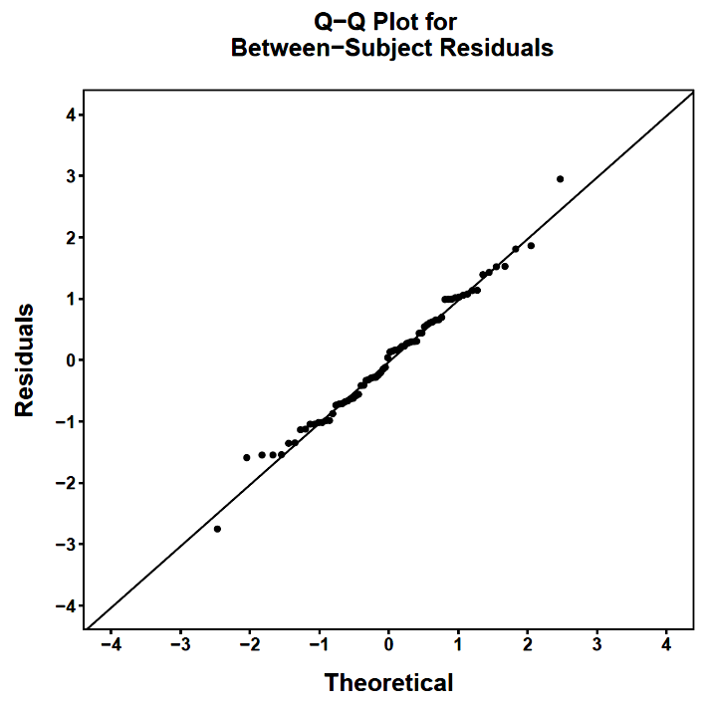
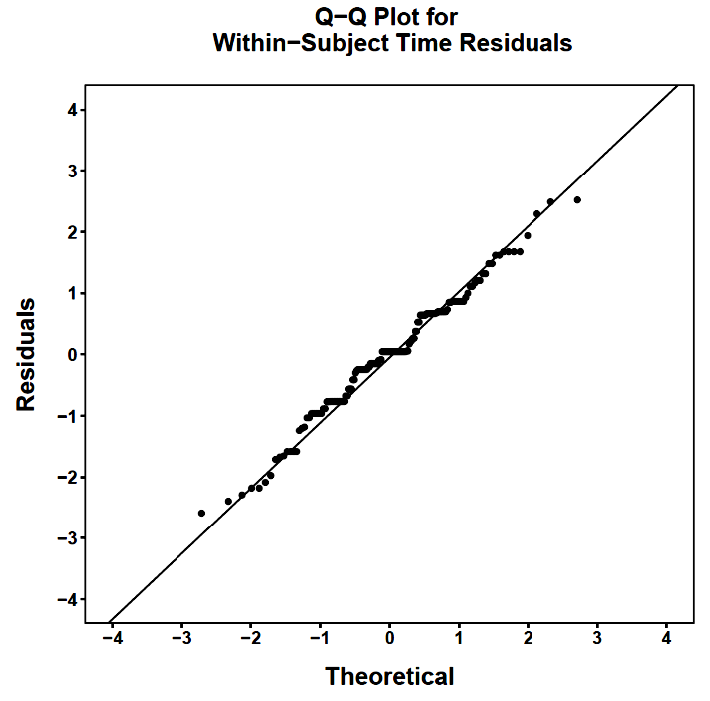
The close approximation to the normal distribution is especially clear in Q-Q plots.

Slide 19
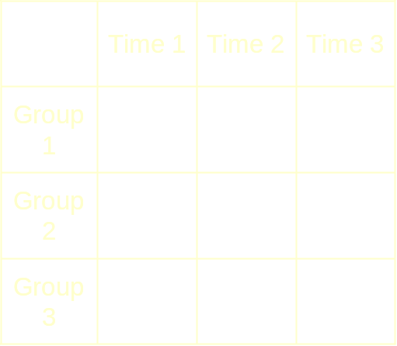
Each group in a repeated measures design has a variance-covariance matrix for the multiple measures. These matrices are assumed to be homogeneous across the groups.
 | Time 1 | Time 2 | Time 3
Time 1 | σ²₁₁ | σ₁₂ | σ₁₃
Time 2 | σ₂₁ | σ²₂₂ | σ₂₃
Time 3 | σ₃₁ | σ₃₂ | σ²₃₃

Slide 20
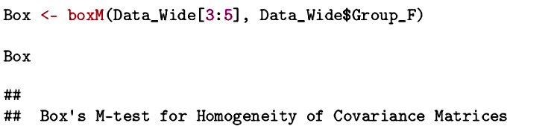
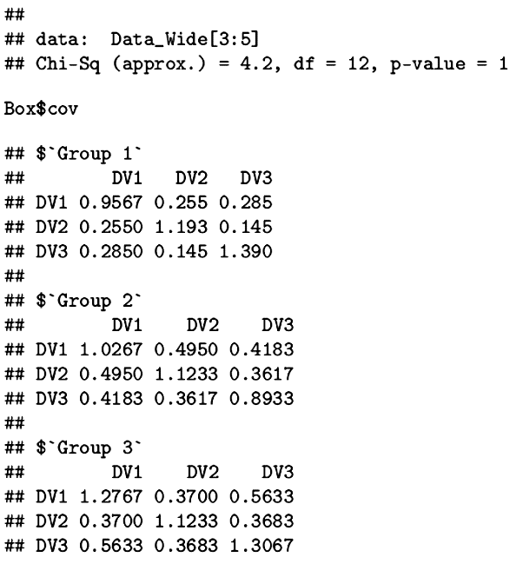
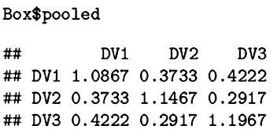
In repeated measures designs, the homogeneity assumption is more general, now including covariances in addition to variances. Box’s test can be used (but assumes normality).
Notes:
This is examined with Box's M test, but must be viewed with caution.
The test is also sensitive to violations of normality.

Slide 21
Repeated measures designs also must satisfy the sphericity assumption. The sphericity assumption is met when the pooled variance-covariance matrix exhibits compound symmetry, but that is unlikely to happen in a repeated measures design.
 | Time 1 | Time 2 | Time 3
Time 1 | σ²₁₁ | σ₁₂ | σ₁₃
Time 2 | σ₂₁ | σ²₂₂ | σ₂₃
Time 3 | σ₃₁ | σ₃₂ | σ²₃₃

Slide 22
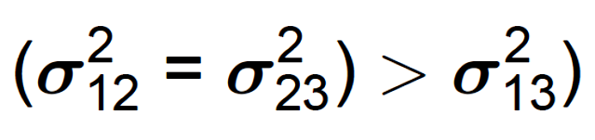
Instead, measures that are spaced farther apart are usually correlated less strongly than measures that are collected more closely in time.
If (Time 2-Time 1) = (Time 3-Time 2)
 | Time 1 | Time 2 | Time 3
Time 1 | σ²₁₁ | σ₁₂ | σ₁₃
Time 2 | σ₂₁ | σ²₂₂ | σ₂₃
Time 3 | σ₃₁ | Σ₃₂ | σ²₃₃

Slide 23
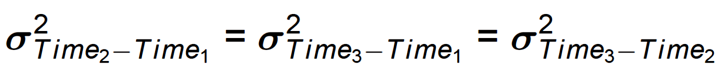
More generally, sphericity is met when there is homogeneity of the variances for all possible difference scores:
A reminder that all repeated measures analyses are difference score analyses.

Slide 24
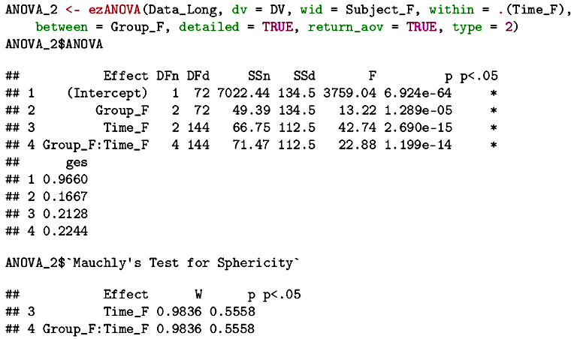
A test for sphericity is available with the ezANOVA( )
function in the ez package.
Sphericity is met for these data.

Slide 25
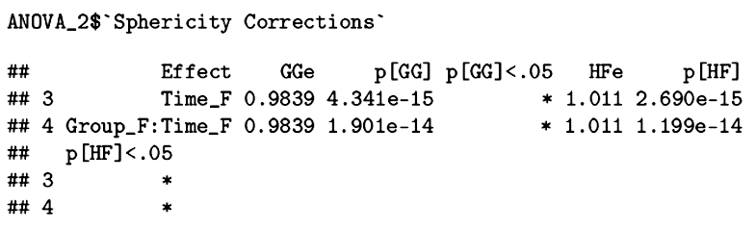
Violations of sphericity are especially problematic. They can inflate the Type I error rate. Remedies include:
  Single df contrasts
  Adjusted df tests (e.g., Geisser-Greenhouse)
  Multivariate tests (no sphericity assumption)
  Resampling procedures (no assumptions)

Slide 26
An alternative is to use the lmer( ) function from the lme4 package. This package is used for multilevel models, of which a repeated measures design is an example. In this case, the repeated measures are treated as nested within subjects. The dummy codes for time and group are used in a no-intercept model so that the coefficients are the cell means for all Group x Time combinations.
Specifying a random intercept for subjects assumes Time is fixed to match the aov( ) assumption.

Slide 27
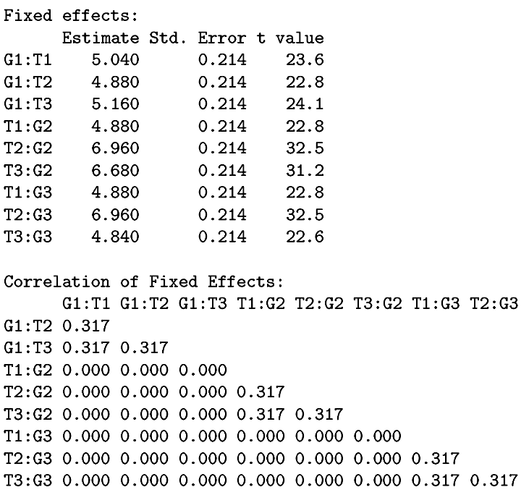
The regression coefficients are the Group x Time means.
Note the compound symmetry assumption imposed on the data.

Slide 28
Because we have means that vary across groups and repeated measures, we have the potential to create linear combinations of groups (L) and measures (M) at the same time.
Our means are in a single vector instead of a matrix (as in LXM). That means we need to combine the L and M weights in a vector as well.

Slide 29
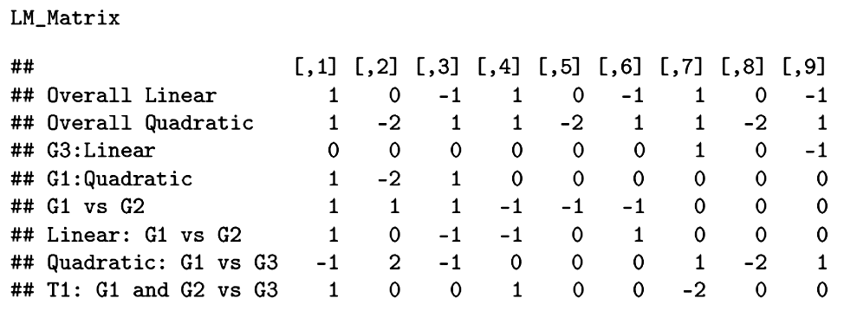
Any combination of means can be examined. For example, previously we found a significant 2 df omnibus test for Time. Now we can see if the separate linear and quadratic components are significant.
Each is a single-df test that does not require sphericity.

Slide 30
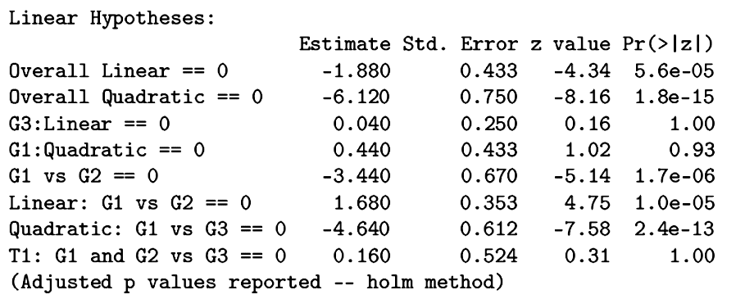
Both the overall linear effect and the overall quadratic effect are significant.

Slide 31
Perhaps we have a more focused question about these temporal trends. We can easily test them in single groups.

Slide 32
There is no meaningful linear trend in Group 3 and no meaningful quadratic trend in Group 1.

Slide 33
We can easily compare trends between groups.

Slide 34
Groups 1 and 2 differ in their linear trends; Groups 1 and 3 differ in their quadratic trends.

Slide 35
The move to repeated measures expands the complexity of the designs that can be tested, but all can be thought of inherently as tests of linear combinations of means. That fact allows us to isolate questions of particular importance despite large numbers and complex arrangements of means. The weights in ANOVA are chosen (theory-driven).
Linear combinations in our first multivariate method will be empirically derived.

Slide 36
Next time . . .
Principal components analysis

